Slide 1
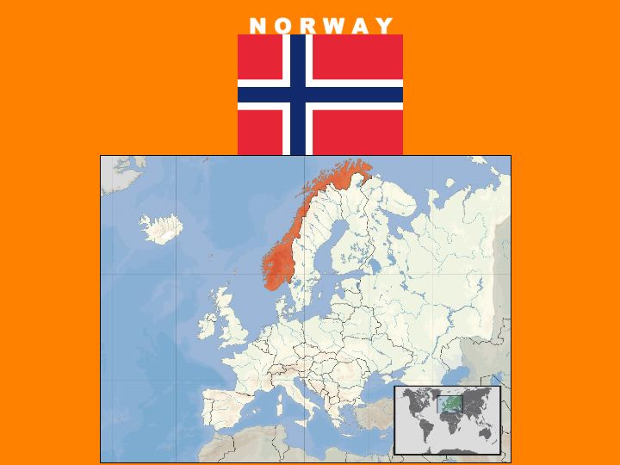

Slide 2
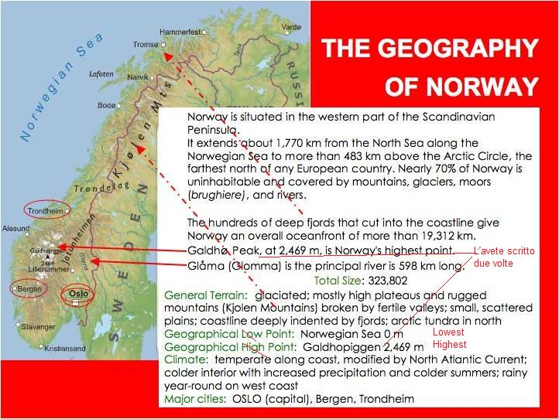

Slide 3

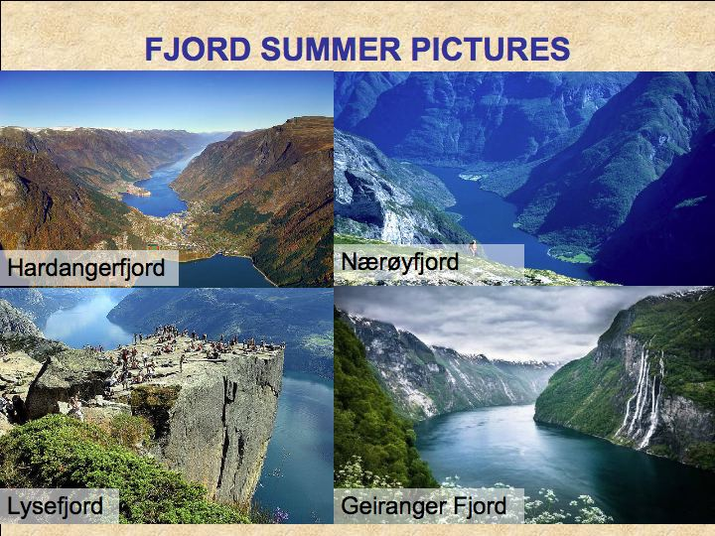

Slide 4

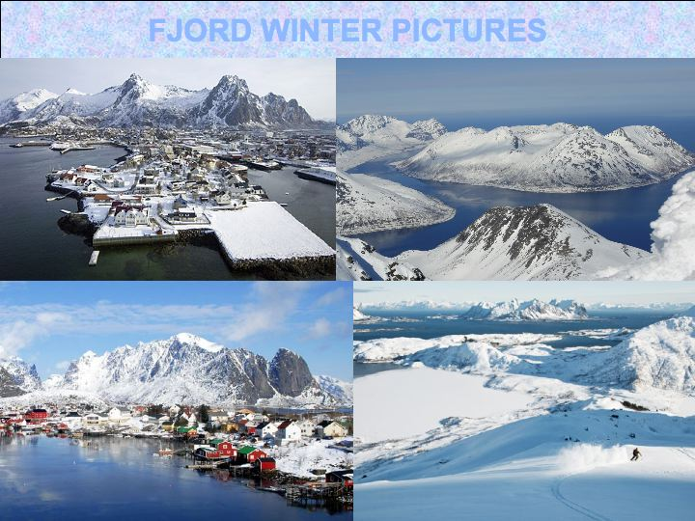

Slide 5
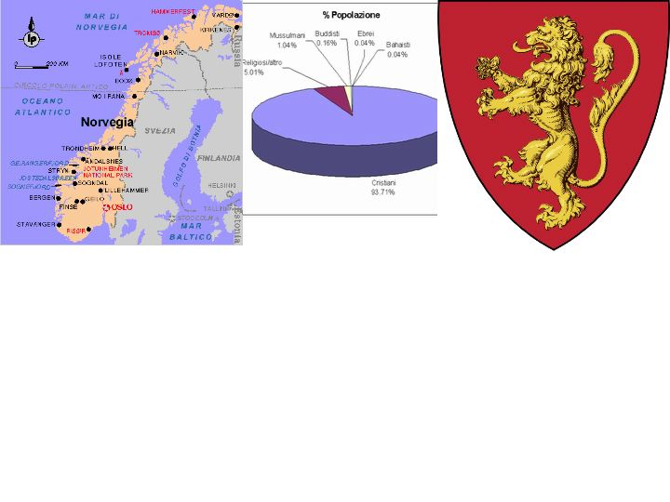
    Major cities: OSLO (capital) - Bergen, Trondheim
    The People of Norway
Languages Spoken: Bokmal Norwegian is the first official preferred written standard language (used by almost 85% of people), Nynorsk Norwegian (official) is the second official preferred written standard language (used by almost 15% of people), small Sami- and Finnish-speaking minorities; note - Sami is official in six municipalities
National Holiday: Constitution Day, 17 May (1814)
Ethnic Group: Norwegian, Sami (The Sami are Norway’s indigenous people)
Religions: Church of Norway that is Protestant (Lutheran) 85.7%, Pentecostals 1%, Roman Catholics 1%, other Christians 2.4%, Muslims 1.8%, other 8.1%
National Symbol: Lion
National Anthem or Song: Ja, vi elsker dette landet (Yes, We Love This Country)

Slide 6
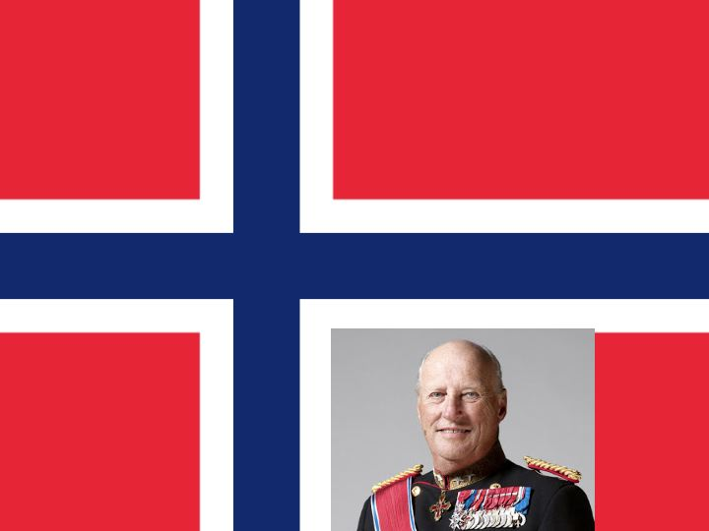
    Government
    The government is a constitutional monarchy. A constitutional monarchy is a monarchy where the king is the head of the country but there is also a parliament elect by citizen and an independent Government.
    Now the king of the Norway is Harald V, who became king in 1991.
    He was born in 1937.

Slide 7
History of Norway
Norwegians, like the Danes and Swedes, are of Teutonic origin.
The history of Norway is very famous for its VIKING AGE which lasted ( durò ) from the 9th to the 11th centuries.
In the late 800s the first Viking King Harald Fairhair unified the Vikings into a single nation. The Vikings settled (si stabilirono) in a large part of Greenland and in a part of Britain and Ireland.
In the 11th century, Olav I became the first Christian king of Norway. He converted many Norwegians to Christianity during his reign.
In 1397 Norway united (si unì) with Denmark and Sweden.
In 1905, Norway became an independent country.
Norway remained neutral in World War I.

Slide 8

    Economy of Norway
Primary sectory
Agricultural Products: barley, wheat, potatoes
Cattle: pigs, bovine, fish (Norway is one of the best place in Europe for salmon fishing)
Natural Resources: petroleum, natural gas, iron ore, copper, lead, zinc, titanium, pyrites, nickel, fish, timber, hydropower
Secondary sectory
Major Industries: petroleum and gas, food processing, shipbuilding; pulp and paper products, metals, chemicals, timber, mining, textiles, fishing
Major Exports: oil and oil products, machinery and equipment, metals, chemicals, ships, fish, natural gas (is the largest natural gas exporte in the world)
Major Imports: other machinery and equipment, chemicals, metals, foodstuffs
Tertiary sector: Norway is very evolved in bank activities, tourism, sea carries maritime transport. Norway has one of the most modern and large shipping fleet.
Currency: Norwegian krone (NOK)

Slide 9

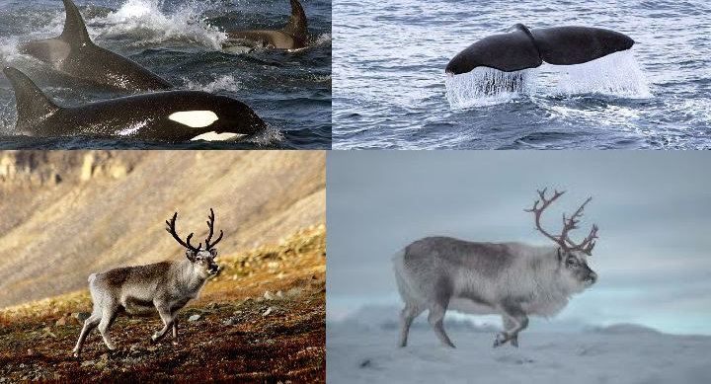
Natural Curiosity
In Andanes, Lofoten islands, there is a WWF camp that studies the sperm whales (capodogli ). Deep ocean and high krill concentration is the natural perfect habitat for sperm whales (capodogli) and orcas (orche).
In the Svalbard islands there are a lots of reindeers. Svalbard reindeer has a peculiarity in the skeleton: it has short legs in comparisation comparison of to other species.

Slide 10

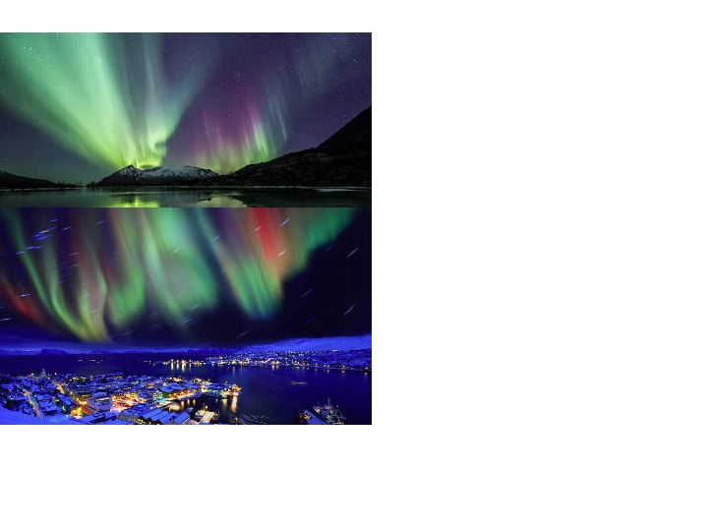
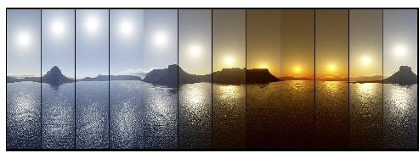
Aurora Borealis and six months with sun
The lights are at their most frequent in late autumn and winter/early spring.
Between the autumn equinox and spring equinox (21 September - 21 March), it is dark between 6 pm and 1 am, and you have maximum chances of spotting the lights. Theoretically, you can see the northern lights all over Norway.
The best places are above the Arctic Circle in Northern Norway in the Lofoten Islands.
What causes the Northern Lights?
The Northern Lights are actually the result of collisions between gaseous particles in the Earth's atmosphere with charged particles released from the sun's atmosphere. Variations in colour are due to the type of gas particles that are colliding.
Norway is a Arctic land and in the north the weather is very particular.
In Norway there are six sunny months with midnight’s sun and six dark month with three light hours a day.
Midnight sun pictures sequence

Slide 11
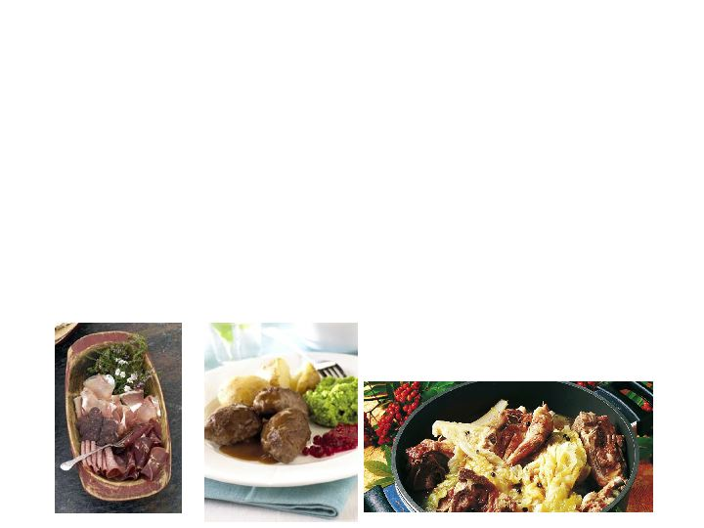
Typical food
Norwegian salmon is popular and has been used by the best chefs in the world for decades for its distinct and delicate flavour makes.
Aquavit
Norway's national drink is a potato-based spirit flavoured with herbs such as caraway seeds, anise, dill, fennel and coriander. It is the preferred accompaniment to Christmas food, but can be consumed year round
Traditional dishes at Christmas time. There is ribbe, roasted pork belly. There is also pinnekjøtt, a dish of lamb (agnello) ribs (costolette)
Meatballs are popular in Norway
Salted liquorice

Slide 12
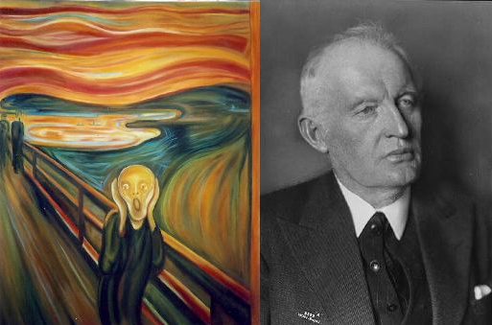
ART
The famous painter Edvard Munch was born in Norway in Oslo in 1863.
He died in 1944 donating all his works to Oslo community. In 1963 the Munch-museet in Oslo
was inaugurated

